Slide 1
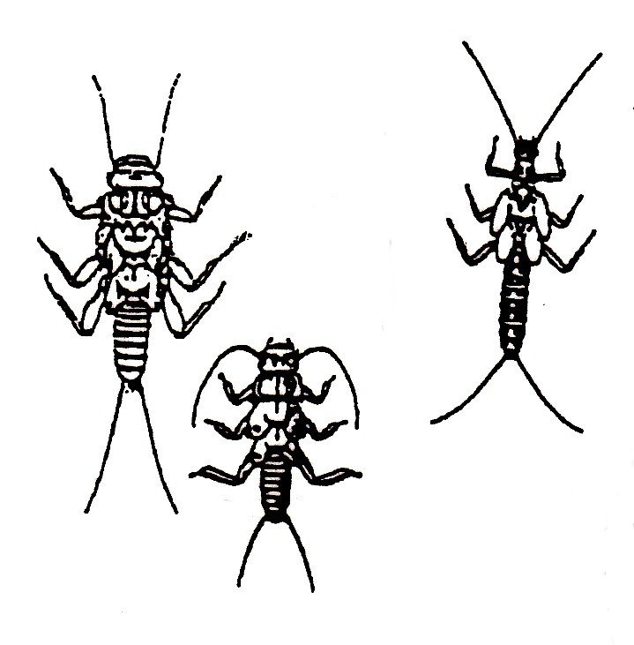
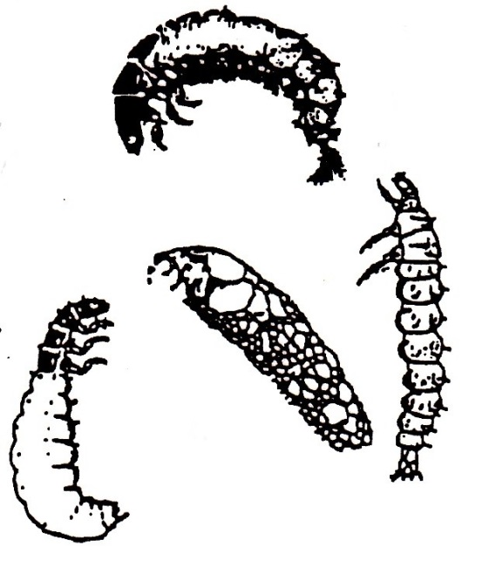
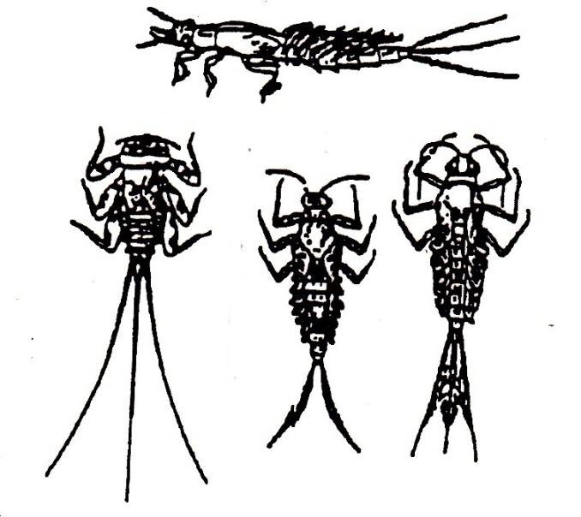
Why riparian care and sediment and debris control?
Common Benthic Invertebrates
Stonefly
Caddisfly
Mayfly

Slide 2
Benthic invertebrates are highly sensitive to
  suspended and settled sediment as well as
  channel disturbance.
Removing cover can increase benthic invertebrate biomass due to increased algae growth (if sunlight can reach the channel)

Slide 3
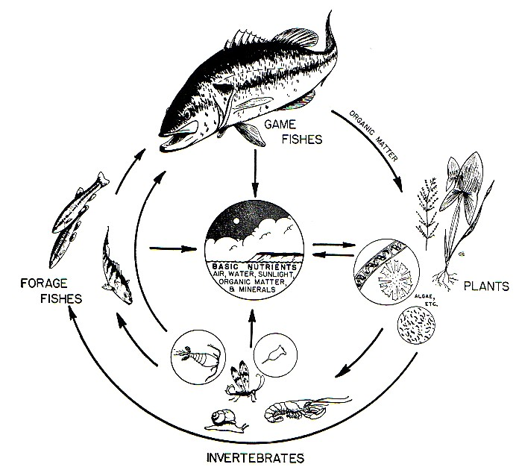
Sediment control importance on all streams
>50% of fish diet is
  benthic invertebrate
  drift
S5/S6 streams >70%
of total stream length

Slide 4
Sediment control importance on all streams
Keep ditch distance between
  culverts to a minimum
Install designated sumps
  and maintain regularly
When using a CMC, extend
  the outlet beyond the road
  influence

Slide 5
Benthic invertebrates diet comprised of allochthonous input and/or algae
Riparian provides allochthonous input (a factor in RRZ establishment)
Sun supports algae growth (algae compensates for loss of allochthonous input when riparian removed)
Too much debris reduces algae growth in stream

